Slide 1

Android Studio for FTC Robotics
Basics and some tips

Slide 2
Ensure Instant Run is Disabled
Goto File → Settings
In left pane, select “Instant Run”
Make sure Instant Run is disabled (“Enable Instant Run to…” is unchecked)

Slide 3
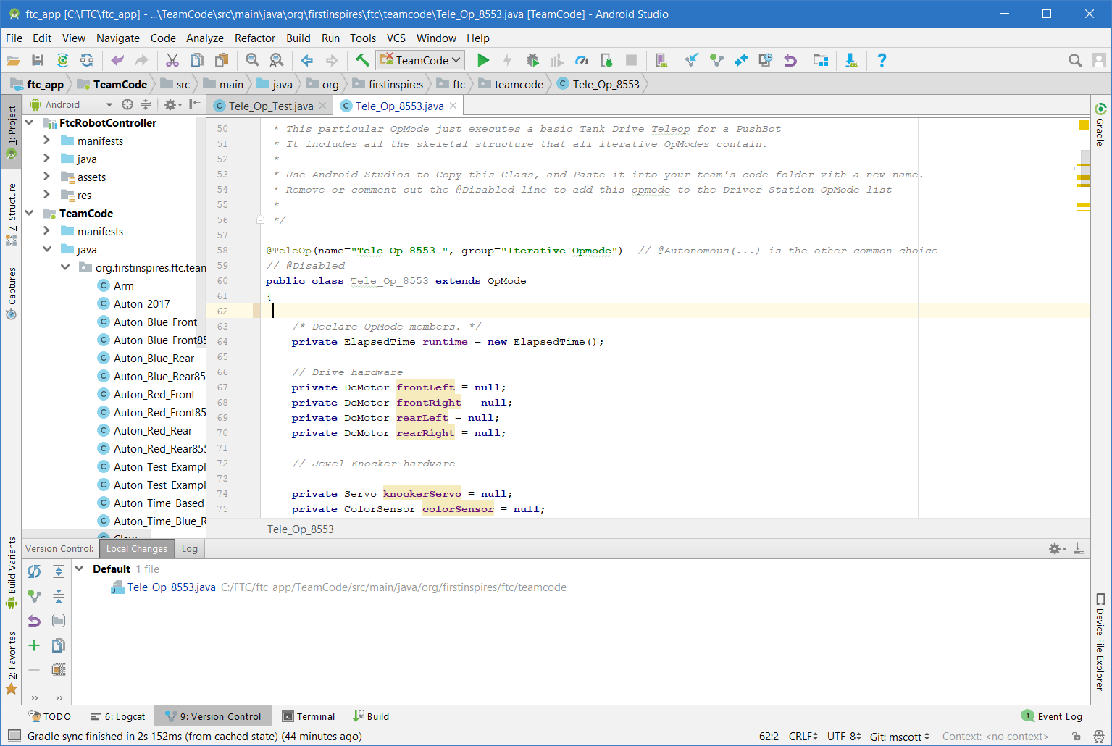
Main Screen
This document tries to explain basic controls and function of the main Android Studio screen

Slide 4
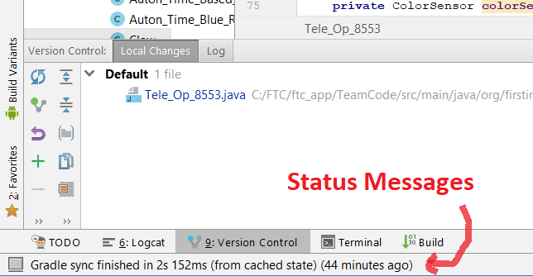
Status
The status message tells when Android Studio is busy. If a build is in progress (and it will do a build at startup), don’t bother to start another until it is done. In this case, it has finished.

Slide 5
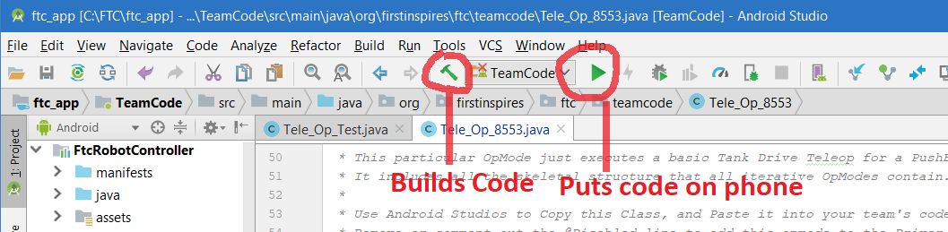
Build and Load on Phone
The hammer button builds the code and the play button loads it on the phone (if connected via cable)

Slide 6
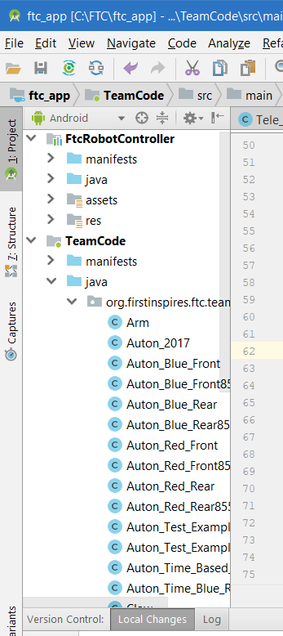
Project Window
The project window allows navigation to and opening code files. Example files are found in FtcRobotController → java → org.firstinspires.ftcrobotcontroller → external.samples

Slide 7
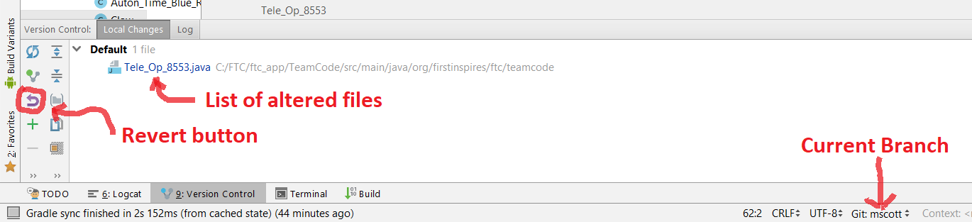
Git Interface
Simple Git controls and information can be found at the bottom of the screen, if “Local Changes” are selected in Version Control. The current branch is always showed at the bottom of the screen, and in the version control screen changed files can be seen and revered, if desired.

Slide 8
Other Controls
If you right click on a object type (like DcMotor in the screen shots), choose Goto → Declaration to go to where the item is created and possibly get more information
Much of the interaction with Git is done through the VCS → Git → … menu

